Slide 1

Setup
Open the Slides @ http://ap.pn/2n6EbzK
Notes:
Images
Android: https://commons.wikimedia.org/wiki/File:Android_robot.png licensed by: Google, with: https://creativecommons.org/licenses/by/3.0/deed.en

Slide 2
Outline
Installation
HAXM (for Windows+Intel)
Emulators
Testing on a real device

Slide 3
Installation
20 min
Install the Java JDK 8
http://ap.pn/2dUCoIU
Download, Install and start Studio (with the sdk)
http://ap.pn/2dUywYh
Download, Unzip and Open the Starter Project in Android Studio
http://ap.pn/2n6EbzK
Or clone our repo and checkout the second commit
http://ap.pn/2n5lbBU
Gif on the next slide →

Slide 5
Enable USB Debugging
If you are planning to test on a real device you’ll need to enable USB debugging.
(Here is a video of these steps: http://ap.pn/2dUyUWJ)
Navigate to your “Settings” app
Scroll down to “About phone”
Tap on the “Build Number” 7 times
Go to “Settings”, scroll down to “Developer options”
Enable “USB Debugging” under “Developer options”
These steps may differ slightly based on your phone vendor, just Google for “Enable USB Debugging <phone name>”

Slide 6
HAXM (Windows+Intel Only)
Allows your emulator to run faster
Only needed for Intel processors
Mac & Linux: You’re set!
Steps
Enable Virtualization Technology in your BIOS:
http://ap.pn/2n6EbzK
Download the HAXM installer in Android Studio’s SDK Manager
If it fails, check your Anti-Virus and make sure Hyper-V is off

Slide 7
Emulators
15 min
First download the emulator image
Make sure to set-up HAXM if you have an intel processor
Pick a small form factor
AMD Processor -> Use an ARM ABI
Intel Processor -> Use an x86 ABI
Gif on the next slide →

Slide 9
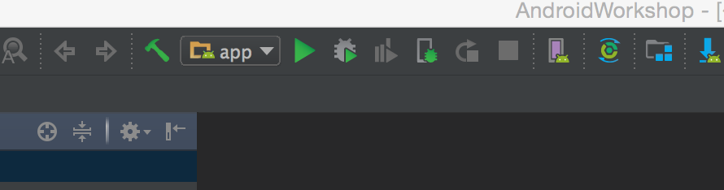
Run the App
15 min
Open your project in Android Studio
Start an emulator or connect your device
Click the run button and select the device
Gif on the next slide →

Slide 11
Congratulations!

